Slide 1
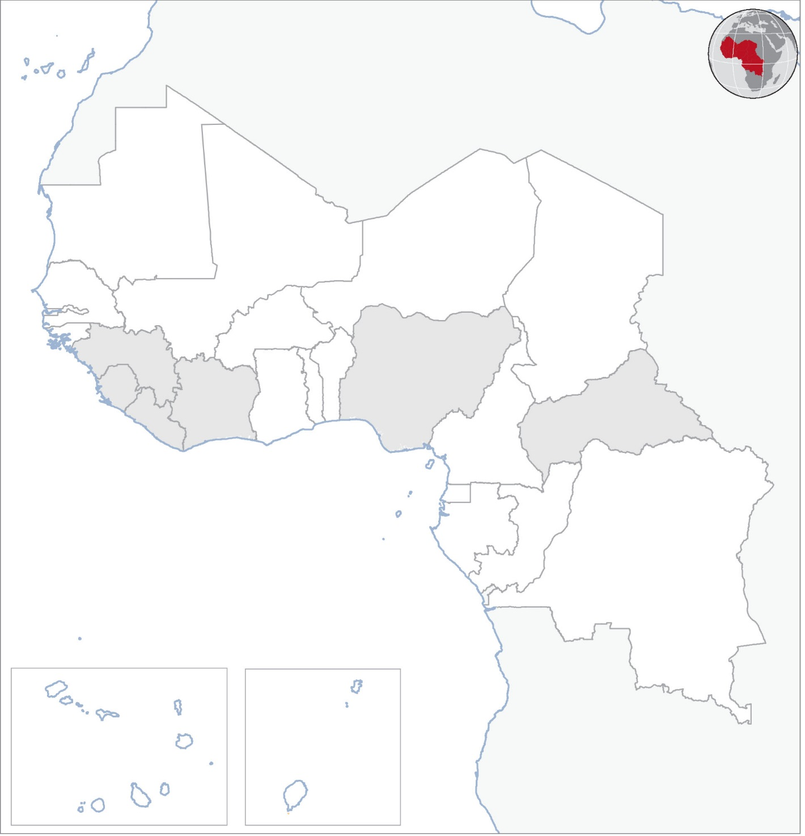
West and Central Africa: Weekly Regional Humanitarian Snapshot (15 – 21 December 2015)
CENTRAL AFRICAN REPUBLIC
On 21 December, electoral officials announced that the constitutional referendum held on 13 December was overwhelmingly passed by 93 per cent of voters, paving the way for presidential and parliamentary elections scheduled for 27 December that are hoped will restore democratic order and help the country rebuild from the current crisis.
Fearing more attacks following clashes between armed groups in Bouar in Nana-Mambéré province in late November, around 6,500 people have fled their homes and sought refuge around the MINUSCA compound and a local church. Some of the displaced spend the night at the sites and return to their homes during the day. Healthcare, water, hygiene and sanitation are the main needs.
EVD REGIONAL
No new cases were reported in Guinea, Liberia and Sierra Leone in the week ending on 20 December. Incidents of people handling dead bodies were reported in three localities in Guinea’s Forécariah prefecture. Door-to-door information campaigns are ongoing across the country focusing on vigilance at the community level. In Liberia, county-specific epidemic preparedness and response plans are being rolled out simultaneously in all the 15 counties as a first step towards forming rapid response teams at the county level. Sierra Leone has begun the transfer of some Ebola emergency response tasks from the national and district level to the Office of National Security and the district health teams.
NIGERIA
On 16 December, the National Emergency Management Agency (NEMA) said that it received 1,187 Nigerians who had returned from Cameroon where they had fled to due to Boko Haram attacks. They arrived between 14 and 16 December at a camp hosting internally displaced persons in Fufore in Adamawa state. The agency also said that 18,600 Nigerians have returned from Cameroon in recent months owing to improving security in northeast Nigeria and concerns by the Cameroonian authorities over their prolonged stay in their country.
COTE D’IVOIRE
The voluntary repatriation of Ivorian refugees in Liberia resumed on 18 December after halting for more than a year due to the Ebola outbreak. Some 654 people left Harper town and another refuges camp in eastern Liberia for their homes in western Côte d’Ivoire. Two more convoys are planned before the end of the year, bringing the expected number of returnees by the end of 2015 to more than 1,000 people. Around 11,000 of the 38,000 Ivorian refugees in Liberian camps have said they wish to return immediately.
REFEREDUM VOTE PASSED
MORE THAN 1,000 RETURN FROM CAMEROON
MAURITANIA
OVER 6,000 SEEK REFUGE AFTER BOUAR CLASHES
MALI
NIGER
CHAD
BURKINA FASO
GUINEA
BENIN
NIGERIA
CENTRAL AFRICAN REPUBLIC
SIERRA LEONE
COTE D’IVOIRE
GHANA
LIBERIA
CAMEROON
REFUGEE REPATRIATION RESUMES
TOGO
EVD REGIONAL
GUINEA EQUATORIAL
CONGO
DEMOCRATIC REPUBLIC OF CONGO
NO NEW CASES REPORTED
GABON
CABO VERDE
SAO TOME E PRINCIPE
Natural disaster
Epidemic
Conflict
Other
Creation date: 22 December 2015 Map data sources: UNCS, DevInfo, OCHA. Feedback: ocharowca@un.org
The boundaries and names shown and the designations used on this map do not imply official endorsement or acceptance by the United Nations.

